Slide 1
IOT WEATHER MONIToring system
Soma Sai Rahul Muddamsetti

Slide 2
Project Goals & Objectives
The goal of this project is to create a weather monitoring system using a Raspberry Pi that gathers and analyzes real-time weather data and has an easy-to-use user interface to show off the platform's versatility and affordability.
In order to raise awareness of the value of weather monitoring, the project's objectives include choosing appropriate sensors, creating software to process sensor data, designing a user-friendly interface, putting data visualization tools into use, testing the system's functionality, and presenting the project's goals and results in a PowerPoint presentation.
Overall, this project emphasizes the advantages of weather monitoring for people and communities while also showcasing the potential of the Raspberry Pi for creating customized weather monitoring solutions.
2 Points

Slide 3
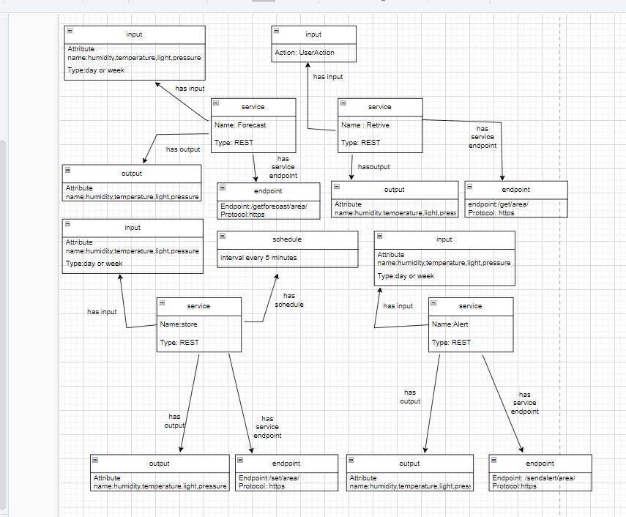
Project Block Diagram
3 Points

Slide 4
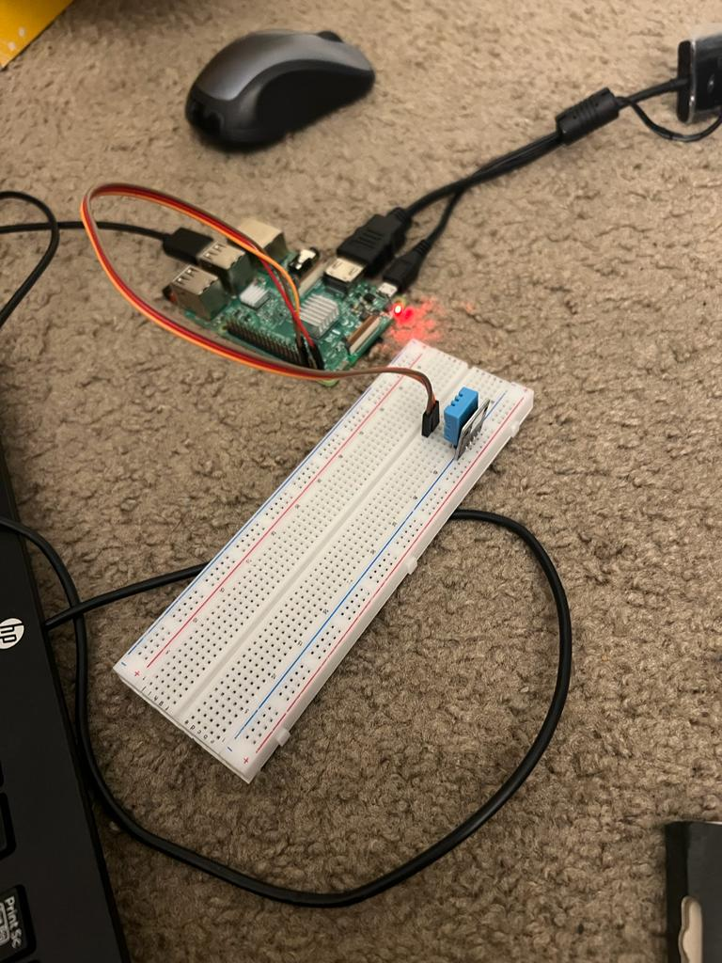
Project Interfaces

Slide 5
Product Development Activities
Picking the right sensors to measure weather variables like temperature, humidity, pressure, and precipitation is the first step in creating an IoT weather monitoring system using a Raspberry Pi.
The sensors are then connected to the Raspberry Pi, and Python programming is used to create software that reads and processes sensor data. In order to present meteorological data in a meaningful fashion, including the usage of data visualization tools like graphs and charts, a user interface is created using GUI libraries such as tkinter or PyQt.
After that, the system is examined and validated in a variety of weather scenarios to guarantee its dependability, accuracy, and usability.
3 Points

Slide 6
Critical Path Analysis
Choosing sensors, integrating them with Raspberry Pi, creating software to handle sensor data, creating a user-friendly interface, putting data visualization into practice, and testing functionality are all steps in the key path for creating an IoT weather monitoring system using Raspberry Pi.
Due to their interdependence, delays in one might have an impact on the project's overall timeframe. To guarantee completion on schedule, efficient planning and management of resources, including time and personnel, are necessary.
The project team can streamline the development process and reduce the possibility of delays or other problems that might have an impact on the outcome by identifying the key path.

Slide 7
SWOT Analysis
A SWOT analysis can be used to determine the system's advantages, disadvantages, opportunities, and threats for an IoT weather monitoring system utilizing a Raspberry Pi.
This system has a number of advantages, such as cost, adaptability, and versatility, which make it a desirable choice for creating unique weather monitoring solutions. Additionally, the open-source nature of the Raspberry Pi gives programmers access to a variety of hardware and software tools, allowing for greater customization and flexibility.
The system's weaknesses, which might affect how well it performs under strong loads, include its low processing speed and memory. The advantages of this system include its ability to enhance weather monitoring across a range of sectors, including agriculture and transportation, and to deliver useful data for study and analysis. Lastly, some dangers to the

Slide 8
Development Issues
1) power consumption: Power consumption is a critical issue when it comes to IoT devices. I have optimized system's power usage to ensure that it does not drain the battery quickly and that it can operate for an extended period.
2) Sensor calibration: Sensors can be affected by various factors, such as temperature, humidity, and environmental conditions. To ensure accurate readings, I have used sensor calibration
3 Points

Slide 9
Bill of Materials
I have borrowed raspberry pi from Hayden library so I got it for free apart from that I bought a key board , mouse, jump cables , led lights and sensors which costed me around 50$

Slide 10
Test Plan Overview
Verified hardware operation, data logging, and communication through unit testing.
Verified data collection, processing, and transmission through integration testing.
Verified monitoring, logging, and the detection of adverse conditions during system testing.
Verified user requirements, usability, dependability, and stability through user acceptance testing
Verified system capacity, reaction time, and recovery through performance testing.
Verified system compliance and security through security testing.

Slide 11
Closing Remarks
I have learned how to set up raspberry pi and connect the sensor through it how to monitor the data using sensor with help of python code also learnt how to send mail using python code and monitor the weather condition

